Slide 1

Hrvatsko asfaltersko društvo
Proizvodnja i tehnologije asfalta s dodatkom recikliranog asfalta i niskotemperaturni asfalti
Jürg Moser
Seminar ASFALTNI KOLNICI 2015
Opatija, 05. – 06. 03. 2015.

Slide 2
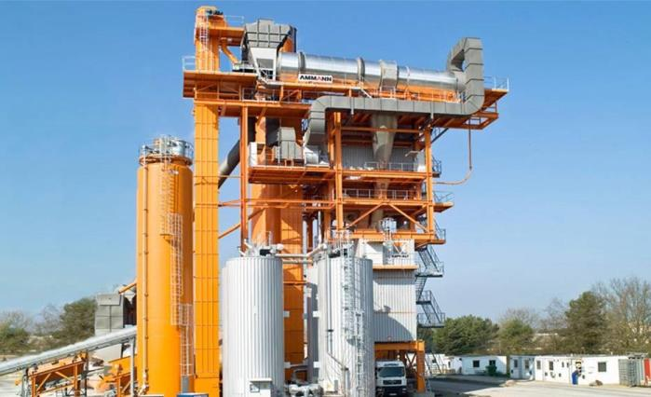
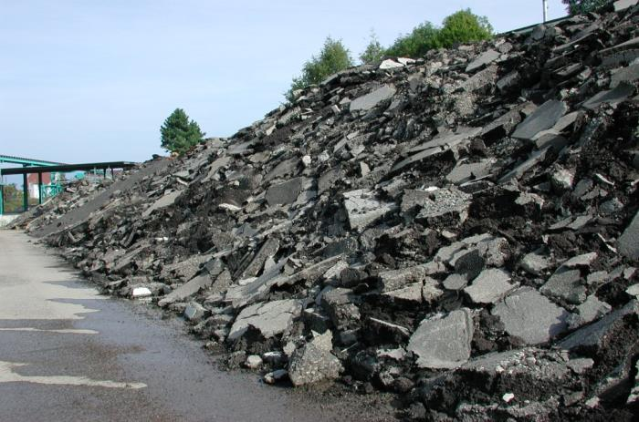
Asphalt recycling
www.ammann-group.com

Slide 3
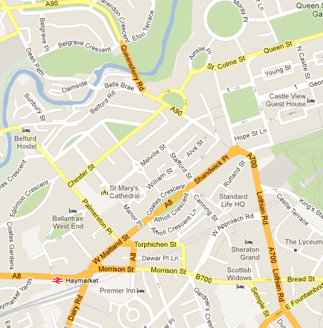

Intact Living Space
We all want an efficient road network. And we all need our nature.
Notes:
Die Produzenten von Asphalt tragen eine große Verantwortung. Ammann trägt diese Verantwortung mit.
Lebensraum und Mobilität in Einklang bringen.

Slide 4


Road Construction Evolution
Topic of our
generation
Ecological
connections
Green Road
Fast and save
connections
Highways
Cities, ports
National connections
Paved Roads
Villages
Local connections
Unpaved Ways

Slide 5
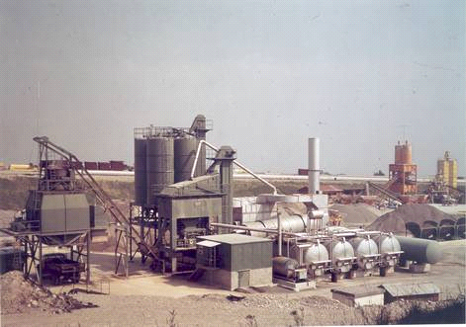
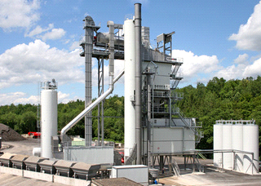



Modern Plants reduce CO2 Emissions
-45 % of the CO2 emissions
Industry Average
Improved Plant
Moisture reduction
Lower temperatures (WAM Foam)
Credits for recycling
More efficient burner and dryer
Optimized insulation and electrical system
Notes:
Q1-4 New age plants reduce the CO2 emission 10%, 45% 90%?
Q1-5 Name 3 different ways to reduce CO2
Notes:
Different ways to reduce CO2 emissions

Slide 6
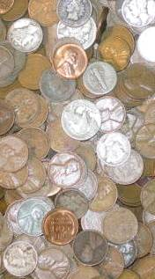
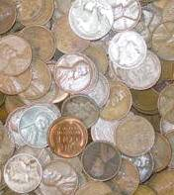
Modern Plants run with lower operating costs
-35 % of the running costs
Industry Average
Improved Plant
Recycling
Lower energy consumption
Notes:
Notes:
Lower CO2 emissions lower costs

Slide 7
Ecological = Economical
Industry Average
Improved Modern Asphalt Plant
High energy consumption
High emission level
High running costs
Low energy consumption
Low emission level
Low running costs
Notes:
Notes:
Different plant levels for different requirements

Slide 8
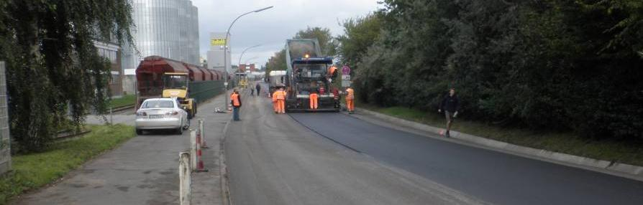

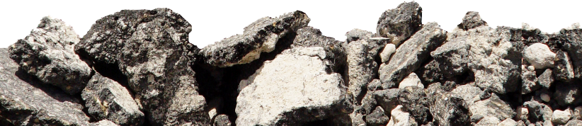
Road Construction - Keeping the Asphalt in the Road
Notes:
The goal is to keep the ball in the air! Keep the asphalt in the road!
AC 0/11
RA (0/11) 91,5%
Aggregate (8/11) 8%
Störbit 0,5%
Mix temperature 160°C

Slide 9
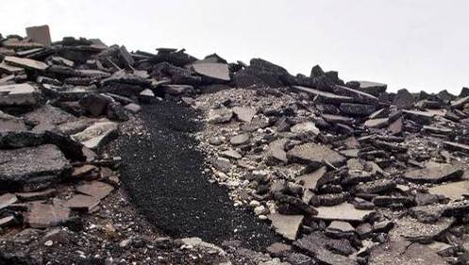

Asphalt Recycling Opens Up Huge Potentials
Potentials
Reducing CO₂ emissions
Conservation of resources
Reducing costs
Success Factors
Regulatory acceptance
Ensuring quality of reclaimed asphalt
Using up-to-date technologies

Slide 10
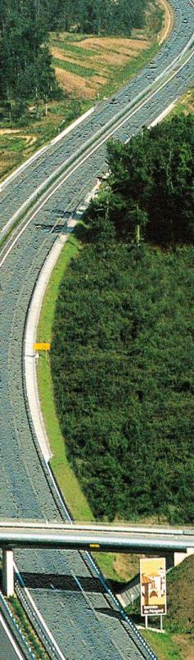
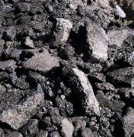
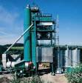
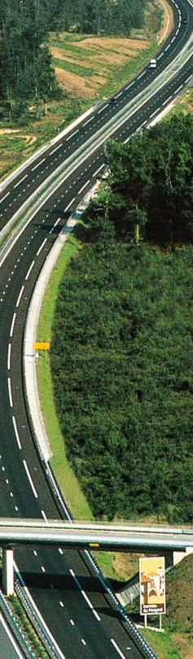
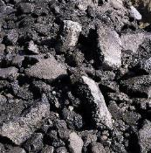
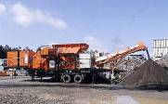

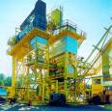
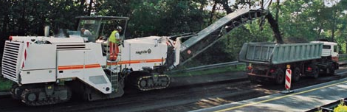
Various Methods of Asphalt Recycling
Landfill
New Material
Substitutes Sub-base
Materials
Storage
Crushing
In-Place Recycling
Continous Quality
very challenginge
Milling

Slide 11
Alowed Content of Recalimed Asphalt
Country | Wearing Course | Binder Course | Base Course
Belgium | 25% | 50%
Denmark | 30% |  | 100%
France | 40%
Germany | 50% |  | 100%
Hungary | 10% | 20%
Ireland | 10% | 50%
Poland | 20% | 30%
Portugal | 10% | 50%
Spain | - | 10-50%
Sweden | 20% | 30%
Switzerland | 30%* | 30% | 60%
*: Depending on traffic load

Slide 12


True Recycling = Future of Asphalt
True
Recycling
Asphalt Layers
30 cm
Gravel Layers
Down-Cycling
Basement
(incl. Installations)

Slide 13
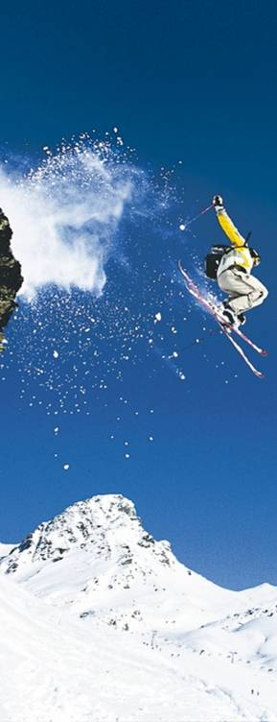
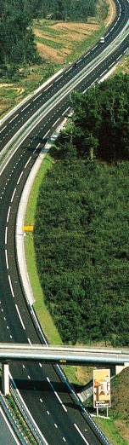
Joint Efforts to bring Innovation into Reality
National and state road authorities
Support new technologies
Road construction companies
Investing in new technologies
Equipment Manufacturers
Developing new technologies

Slide 14
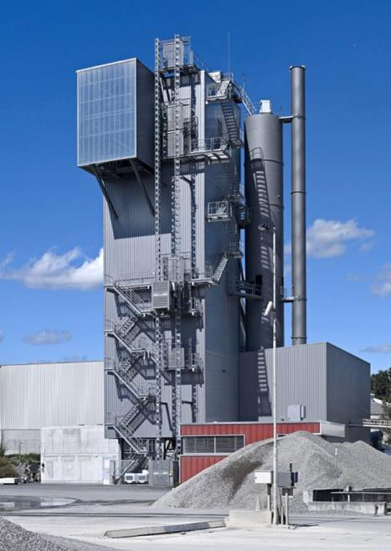
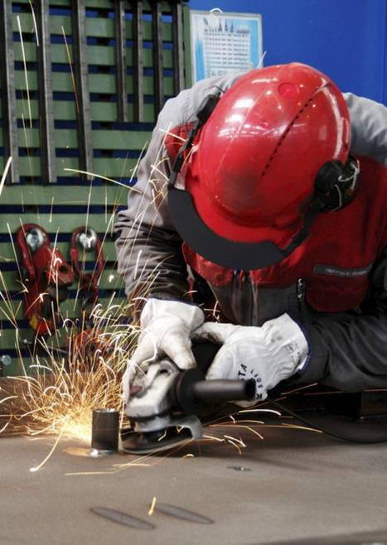
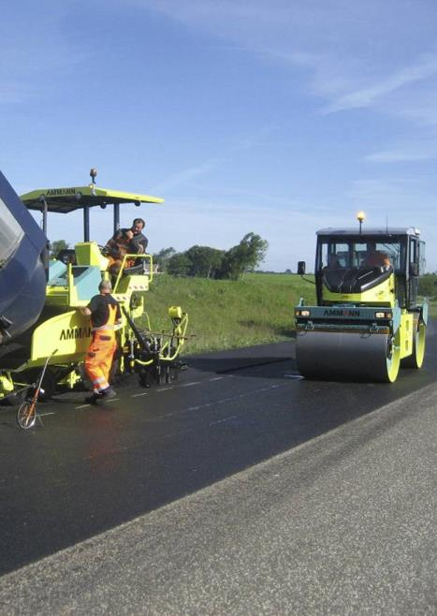
Asphalt Recycling – Material Handling
www.ammann-group.com

Slide 15
Requirements for High Rates of RA Addition
The prerequisites for this are
careful sourcing,
effective receiving inspection,
separate storage,
extensive initial type tests and
machine- and process-specific requirements to be met by the mixing plant.
DAV, 2011

Slide 16
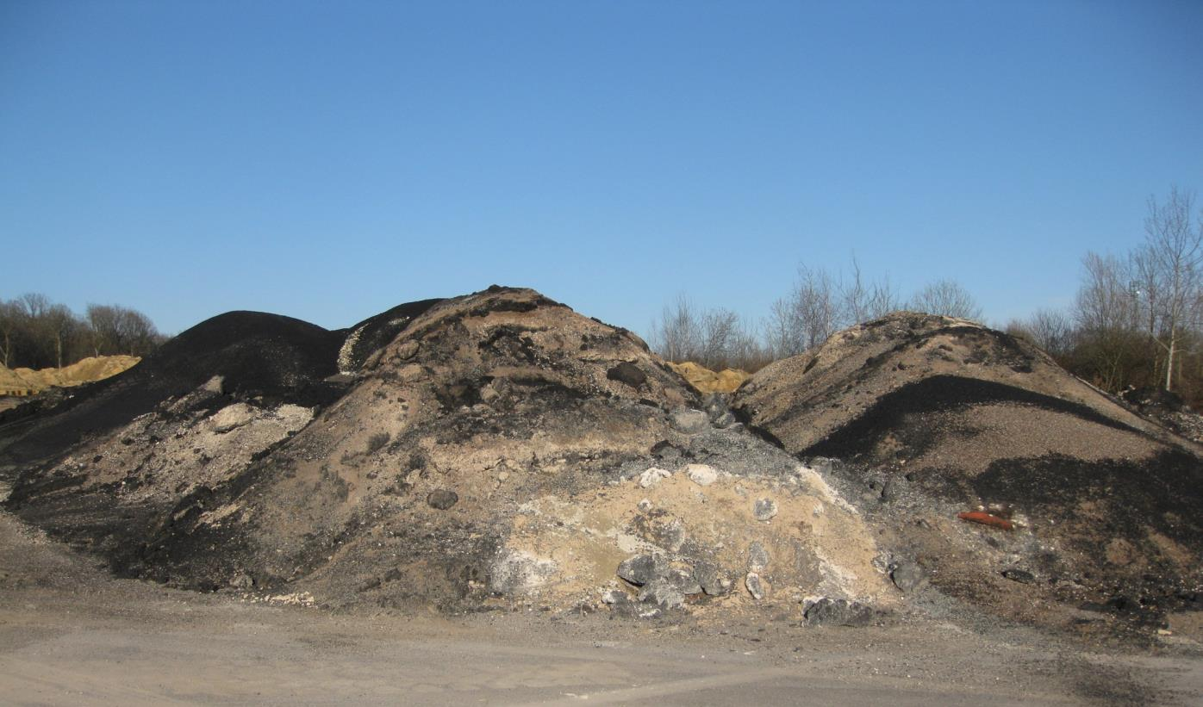
Waste of Asphalt Next Due To Start-Up and Shut-Down
Undefined and inhomogeneous
mixture of aggregates and bitumen.
Cannot be used for high quality asphalt

Slide 17
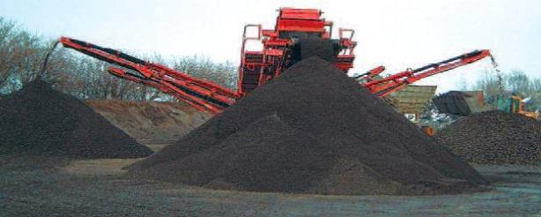
Processing and Handling of RA Material
Bitumen 4,0 %
Filler 10,6 %
Sand 45,8 %
> 2 mm 43,6 %
RA 0/22
RA 0/22
Screening
Bitumen 5,1 %
Filler 12,4 %
Sand 52,5 %
> 2 mm 35,1 %
Bitumen 3,6 %
Filler 6,9 %
Sand 24,7 %
> 2 mm 68,4 %
RA 0/8
RA 8/22
17
Notes:
17

Slide 18
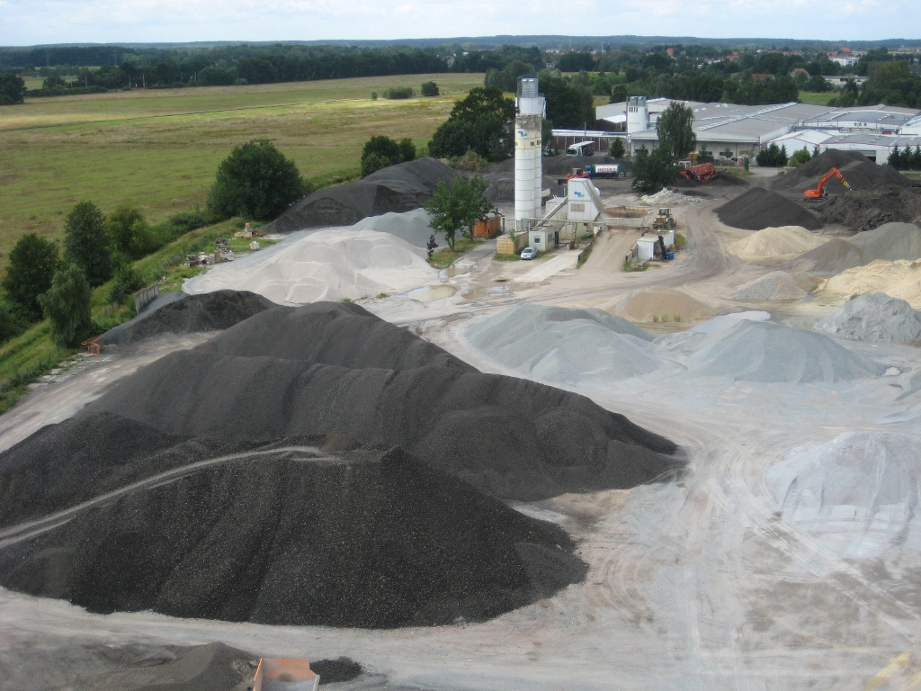
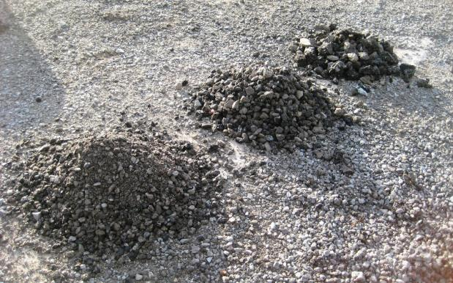
Processing and Handling of RA Material
16/32
8/16
0/8
18
Notes:
18
Installation in Gardelegen

Slide 19
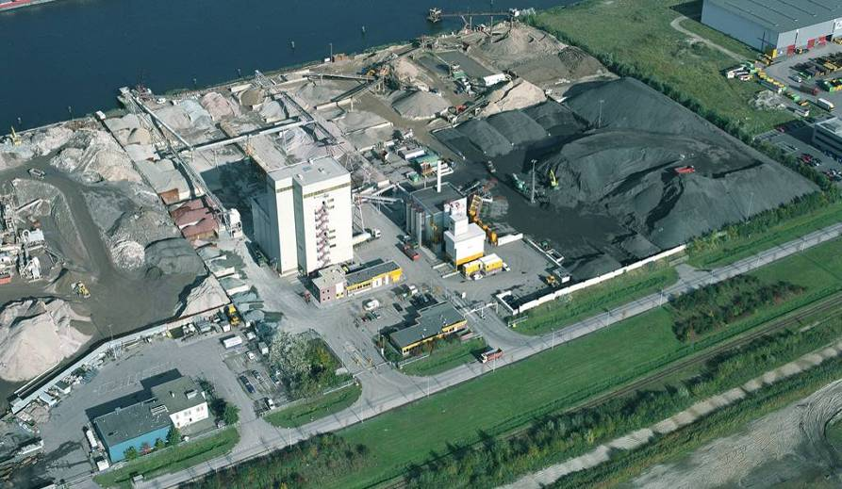
Cost Benefits
as1 Auftragsverwaltungs- und Dispositionssysteme
Grain size-sorted reclaimed asphalt
Homogenous stockpile
Production: 600‘000 t per year
RA: 300‘000 t per year
= 50% RA = -38% Raw Material Costs

Slide 20
Typical Asphalt Recipe
Base course

Slide 21

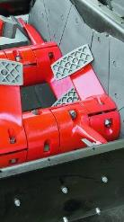
Reclaimed Asphalt + Fresh Bitumen
Reclaimed
asphalt
Fresh bitumen
Double-coated grains
+
=
Twin-shaft
mixer
Homegenous
mastic
+
+
=

Slide 22
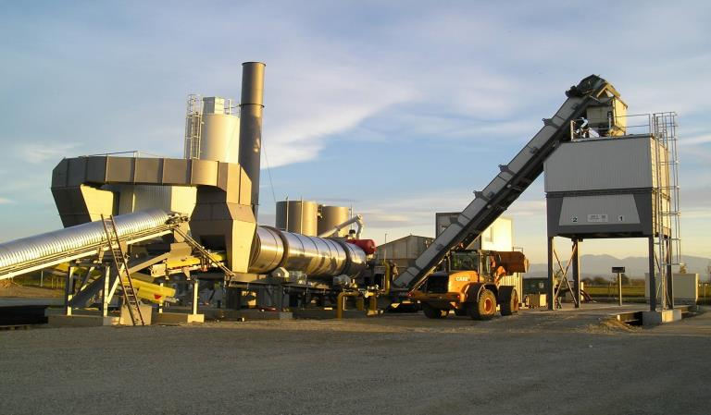
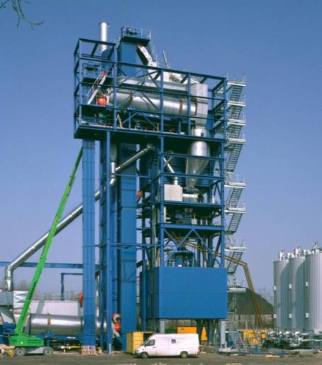
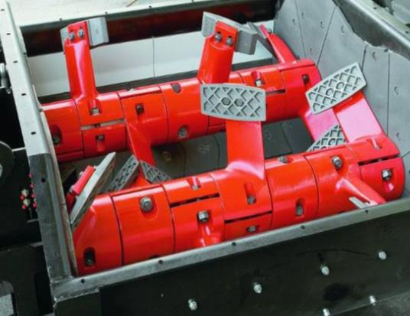
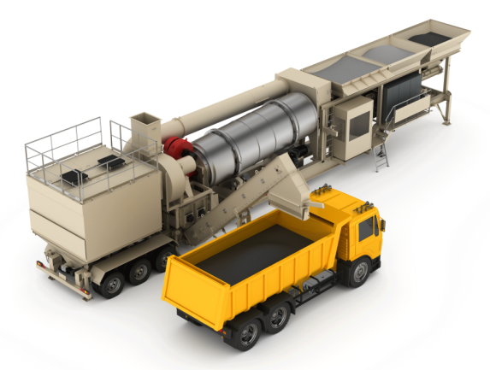
Action Force Mixer For Homogeneity of the Mastic
Continuous asphalt production
Batch asphalt production

Slide 23
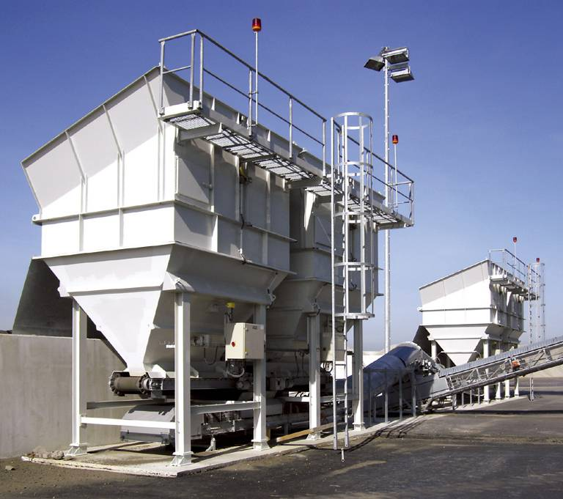
RAP-Feeder
RAP feeder designed to fit the purpose

Slide 24
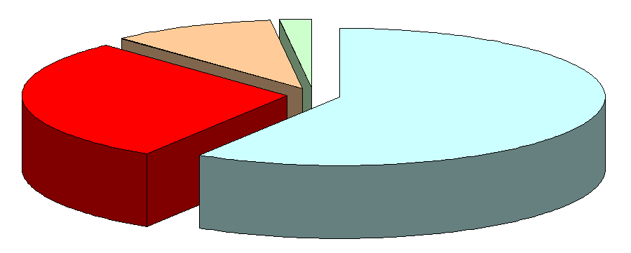
Roofing for Deposits and Cold Feeders
as1 Auftragsverwaltungs- und Dispositionssysteme
Energy inputs for heating and drying of RA material
(Calculation base: 3% moisture, 165°C)
Exhaust gases 9%
Thermal losses 2%
-1% Moisture = +10% Fuel Saving!
Moisture 30%
Aggregate 59%

Slide 25
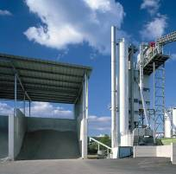
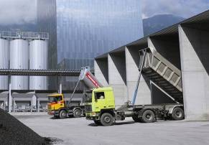
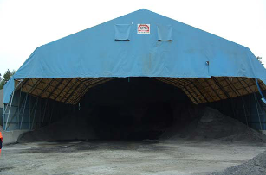
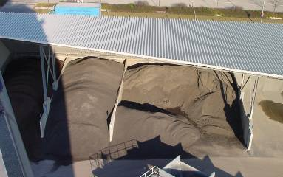
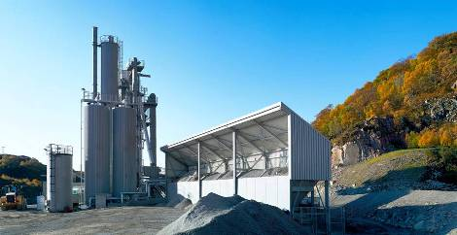
Roofing for Deposits and Cold Feeders
as1 Auftragsverwaltungs- und Dispositionssysteme

Slide 26
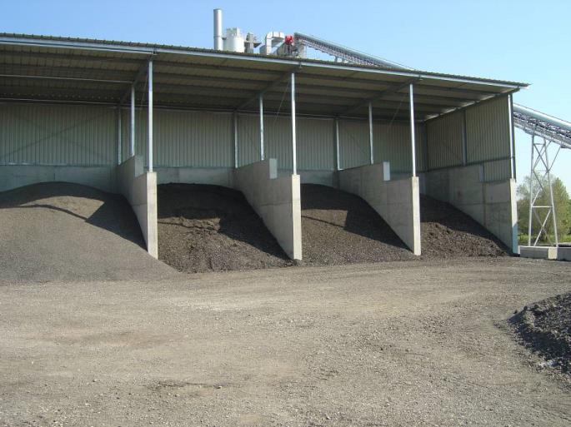
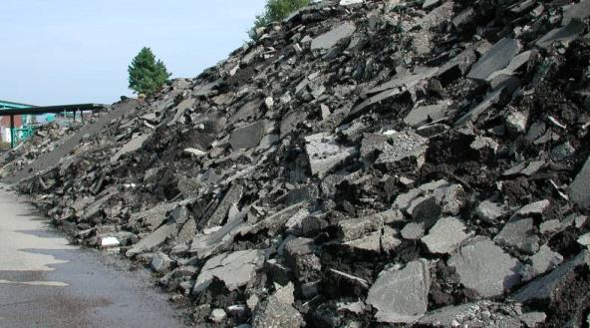
Storage: well separated recycling material fractions
covered stockpile for crushed RA
roofed storage boxes for milled RA from the top asphalt road layers

Slide 27
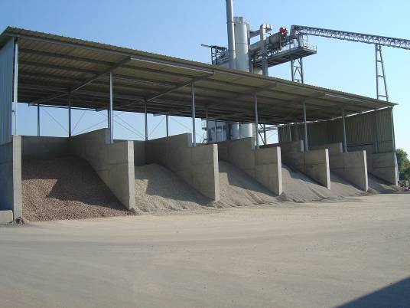

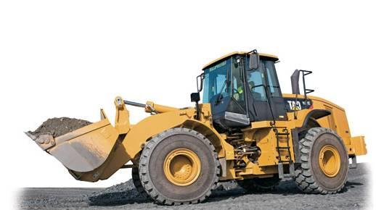
CO₂ Reduction through Smart Stockpiles and Loading
0.5 – 1.0% less moisture:
0.3 – 0.7 kg less heating oil
per tonne
4 %
Moisture
6 %

Slide 28
Asphalt Recycling – Plant Technologies
www.ammann-group.com

Slide 29
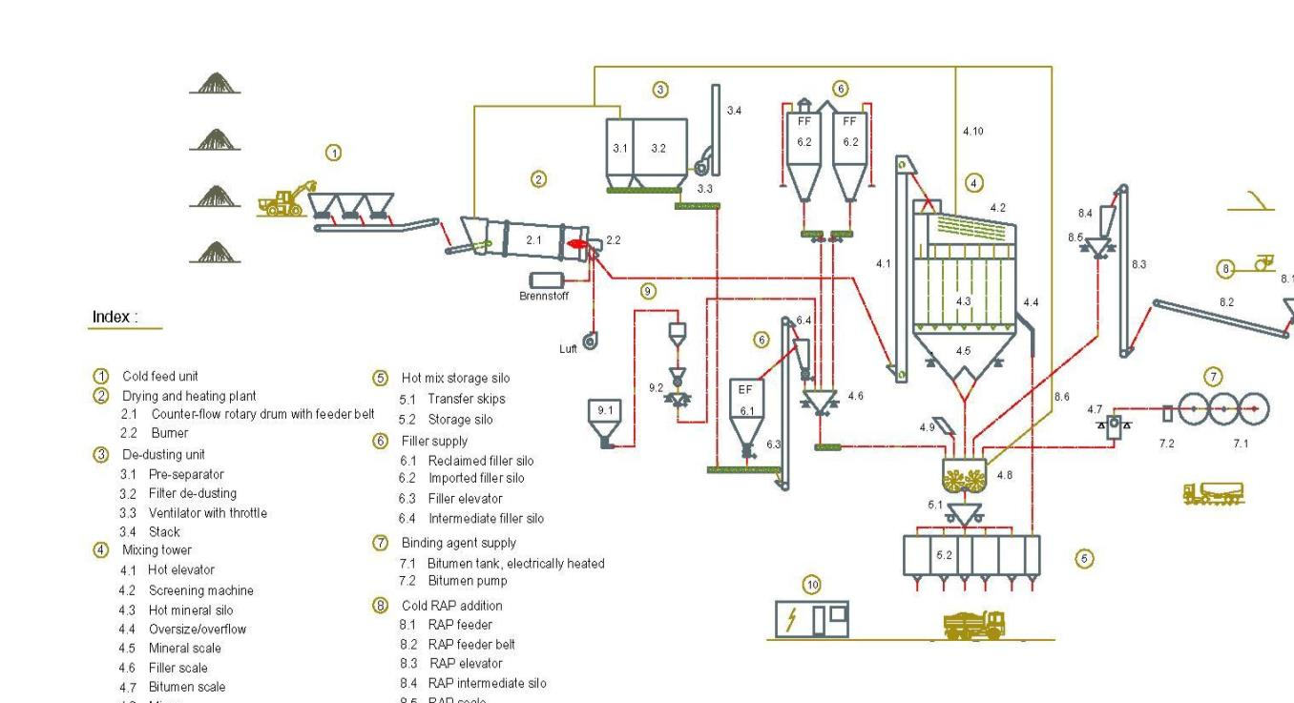
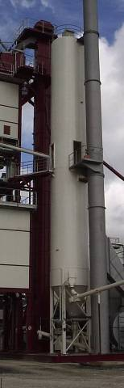
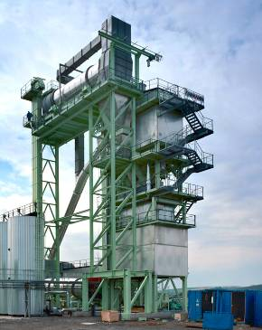
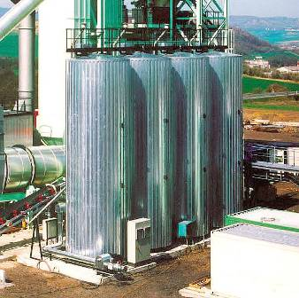
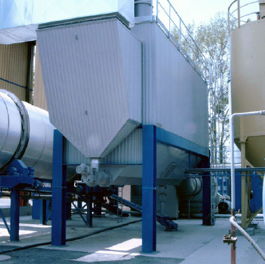
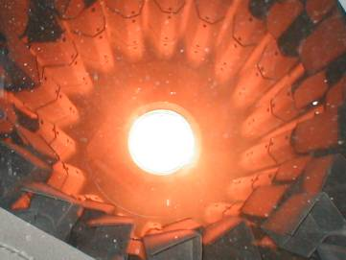



Typical Batch Process
Mineral
Füller
Bitumen
Mischen
Entleeren
0 10 20 30 40 50 60 70
Discontinuous Production

Slide 30






Different Techniques To Keep the Asphalt in the Road
dedicated counter flow drum
parallel drum
in drying drum
in pug mill
in elevator
0%
30%
50%
75%
100%
Possible Ratio of Reclaimed Asphalt

Slide 31


RA Cold Addition via Hot Elevator
as1 Auftragsverwaltungs- und Dispositionssysteme
RA cold addition via hot elevator for up to 15%
- Simple, cost efficient installation
- Suitable for bypass operation only
Limits:
Clogging in hot elevator and hot mineral bins

Slide 32




RAC – Cold RA (directly into mixer)
30% RA @ 3% H₂O
210°C
Notes:
+ The hot aggregate is cooled down by the RA material before adding the binder, thus the added bitumen is not in touch with the very hot mineral aggregate (conventional mixing cycle).
+ The binder contained in the RA material partially covers the virgin aggregate.
- The conventional mixing cycle is longer than the progressive mixing cycle.
- The added binder is not fully available for the fresh aggregate. The binder/filler ration is inaccurate and therefore the stiffening effect reduced. Partially the filler adheres to the RA material which already contains filler.

Slide 33

Cold recycling in Mixer
Aggregate
Recycling
Steam
Filler
Bitumen
Mixing
Discharge
0 10 20 30 40 50 60 70

Slide 34

RAC – Cold RA (directly into mixer)
„conventional“ mixing cycle
30% RA
@ 3% H₂O
Aggregate
RA
Evaporation
Filler
Bitumen
Mixing
Emptying
210°C
0 10 20 30 40 50 60 70
„progressive“ mixing cycle
Aggregate
RA
Evaporation
Filler
Bitumen
Mixing
Emptying
0 10 20 30 40 50 60 70
Notes:
+ The hot aggregate is cooled down by the RA material before adding the binder, thus the added bitumen is not in touch with the very hot mineral aggregate (conventional mixing cycle).
+ The binder contained in the RA material partially covers the virgin aggregate.
- The conventional mixing cycle is longer than the progressive mixing cycle.
- The added binder is not fully available for the fresh aggregate. The binder/filler ration is inaccurate and therefore the stiffening effect reduced. Partially the filler adheres to the RA material which already contains filler.

Slide 35
RAC – Coold RA (directly into mixer)
MC [%]
8
7
6
5
4
Design point
3
2
1
0
10
15
20
25
30
35
40
RA feed rate [%]

Slide 36

Cold Recycling, up to 30% recycling material
Bucket elevator
Puffer silo
100
Weighing scale
Steam evacuation from mixer
0

Slide 37


RAC Feeding and dosing in Mixer
Bucket elevator and steam evacuation Belt weighing unit

Slide 38

Ammann RAH50 Drum
RA addition into aggregate drum for addition rates of 40-50%
New design from Ammann , due to great demand in southern Europe markets
High RA addition rates with low-cost installation
Suitable for bypass-operation only
Tangential RA- material feed
Aggregate feed

Slide 39

Cold recycling via Ring in Drum
Aggregate
Recycling
Filler
Bitumen
Mixing
Discharge
0 10 20 30 40 50 60 70

Slide 40


Operation of the dryer
MIX enters in a special anular chamber where it continues to increase the temperature in a gentle way up to output without being affected by high flame temperature

Slide 41

CB 150 with RAH50/2080

Slide 42

Retrofit in Italy of RAH50/25100

Slide 43

RAH – Hot Recycling
60% RA
@ 3% H₂O

Slide 44
Warm recycling via prallel drum
Aggregate
Recycling
Filler
Bitumen
Mixing
Discharge
0 10 20 30 40 50 60 70

Slide 45

Principle of parallel flow
Gas
RAP
900
800
700
600
500
400
300
200
100
°C
0

Slide 46

Hot Recycling, up to 60% Recycling material
100
Recycling drum
Recycling silo
Bucket elevator
Weighing scale

Slide 47

Recycling Drums (Parallel flow)
270°C

Slide 48

Recycling Drums (Parallel flow)

Slide 49

Recycling Drums (Parallel flow)

Slide 50

Recycling Drums (Parallel flow)

Slide 51

100% Recycling Device
Process air heater
RAP dryer
Process air circulation

Slide 52
100% Recycling Device (protected)
Filter
recirculated, hot air
Fresh air
Dryer- and Heating Drum
(turning)
Combustion
chamber
Recycling-Asphalt
Gas mixing
Hot Recycling-Asphalt: 165 °C
Low ageing of bitumen
No radiation heat
Low oxygen content
High efficiency
Counterflow dryer
Air recirculation
Low emissions (VOC)
Indirectly heated recycling drum

Slide 53


as1 Dynamic RA addition – RAP usage made easy
… easy RAP ratio change during the ongoing production process
Benefit
Continuous change of RAP ratio during production process by slider
One recipe is sufficient for various RAP ratios
Integrated wizard for guiding through the recipe input process
„as1 Dynamic RA addition is one of the best developments by Ammann.“
Helmut Gaal, Plant manager MSO Mischanlagen GmbH
Notes:
This module does not require additional Hardware. It is based on RAP analysis from the laboratory.
RAP addition into the mixer only is supported by this module.

Slide 54


as1 Dynamic RA addition – arguments
Thanks to as1 dynamic RA addition, you get one continuous protocol.
Thanks to as1 dynamic RA addition, you get one continuous protocol.
Thanks to as1 dynamic RA addition, Temperature is under control.
Notes:
Based on an estimated Bitumen price of ~ 600 $/ t of Bitumen (2013). (Bitumen reduction depending on remaining bitumen content in the rap), more RAP means as well higher virgin mineral temperatures.
Thanks to RAD higher recycling rates are produced
Thanks to RAD mix temperatures are more stable which equals higher quality
Thanks to RAD you get a continuous mix documentation instead of multiple productions from different recipes.

Slide 55
Productivity Partnership for a Lifetime
Thank you for your attention!
www.ammann-group.com

