Slide 1
Lowering the Asphalt Production Temperature
www.ammann-group.com

Slide 2

Our Planet
http://maptd.com/
Notes:
This Fascinating view of the earth is a global average of data recorded by the tongue twisting Sea-viewing Wide Field-of-view-Sensor (SeaWiFs) over the entirety of its 13 year operational history – 1996-2010.
During its lifespan this sensor on GeoEye’s OrbView 2 satellite measured worldwide levels of chlorophyll – the green pigment which allows plants to obtain energy from light. As NASA Earth Observatory explains, at sea the colours in the map represent areas where phytoplankton is most common, on land the the density of vegetation:
An NDVI of zero means no green plants and a high value (0.8 or 0.9) is a thick canopy of green leaves.
As to why monitoring phytoplankton levels is really important:
It’s the blooming and die-off of the phytoplankton that form the center of the oceanic food web…a direct indicator of the seas’ ability to support life.
NASA Earth Observatory image by Jesse Allen, using data provided courtesy of the Ocean Color Web team. Caption by Patrick Lynch and Mike Carlowicz.

Slide 3




CO₂ emission per ton of Asphalt in Australia
20
Indirect Emissions
Direct Emissions
Production of raw
materials and energy
On the Mixing Plant
20 kg CO₂
15
30 kg CO₂
Total
50 kg CO₂
kg CO2 per t of Asphalt
Lower mixing Temp.
Less moisture content
10
Asphalt-
Recycling
5
0
Aggregates
Bitumen
Electricity
Bitumen Storage
Logistics
Dryer
Australia, model calculation, Transport not considered (5-15 kg CO2 per t of Asphalt)

Slide 4
Lower Temperature reduces Energy Consumption
Additives
HMA
Foam
1.5 kg
Oil
Heating
Energy Consumption
per ton asphalt
Heating &
Drying
CMC
115°C
180°C
0°C
50°C
100°C
150°C
200°C
Cold
Asphalt
Half Warm
Asphalt
Warm
Asphalt
Hot
Asphalt
Technology Trend = Lower Temperatures
Notes:
Die Zukunft liegt in der niedrigen Temperatur. Sicher nicht höher!

Slide 5
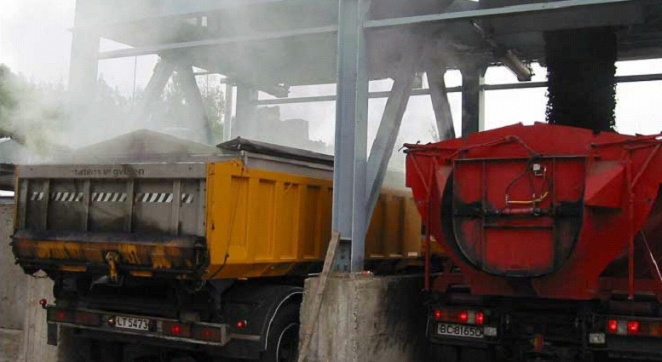
Loading of Hot Mix and Ammann Warm Foam
Hot-Mix
Foam Asphalt
Temperature reduction of 10°C reduces fume by approximately 50%.
50 °C cooler = - 80% emissions.
Emissions during loading
180 °C
~ No Emissions
115°C

Slide 6
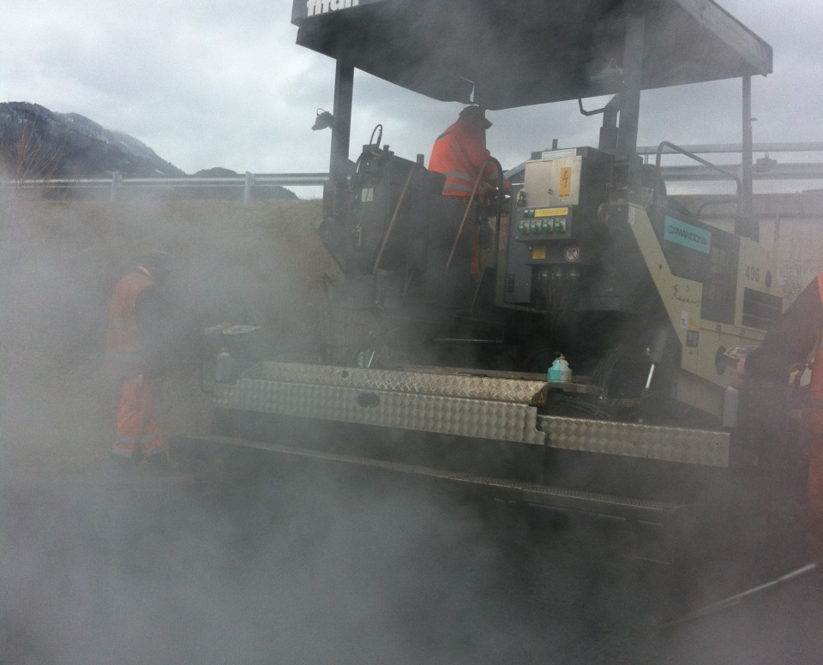
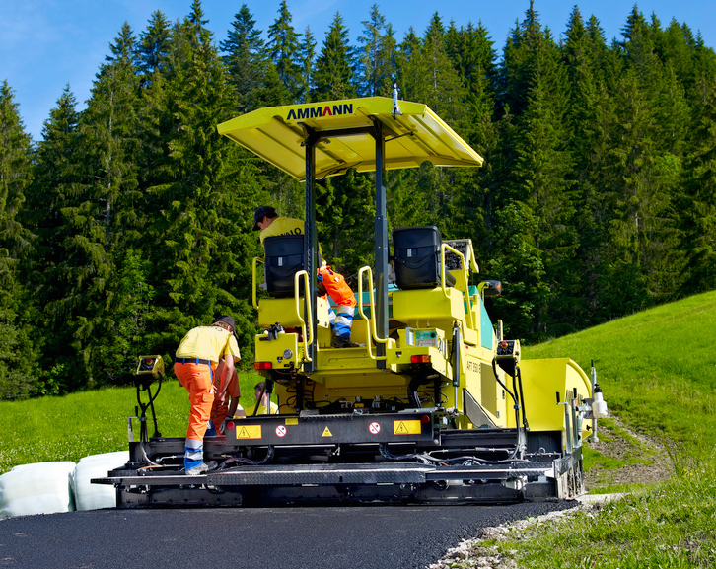
Lower Emissions at the Construction Site
Emission during paving
165 °C
No emissions
100°C
Notes:
Emissions of the asphalt not only occur on the asphalt mixing plant, but also on the construction site during paving. On the construction side as well, the emissions can be reduced dramatically. This reduction in emissions increases the conditions of the paving workers significantly. You even don’t smell the asphalt on the site anymore.

Slide 7
Foaming: Same Viscosity at Lower Temperature
Bitumen B 50/70
Bitumen with Wax
Viscosity of Bitumen
Foamed Bitumen
0
Temperature [°C] and / or Time
Schematic Illustration

Slide 8
Verdichtungsfenster – Abhängig von der Technologie
Früheres Ende
Standard Bitumen
Bitumen mit Wachs
Viskosität des Bitumens
Schaumbitumen
Time
Einbau &
Verdichtung
Verkehr
Lagerung
Mischen
Transport
Abkühlen
Schematic Illustration

Slide 9
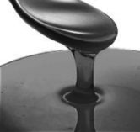


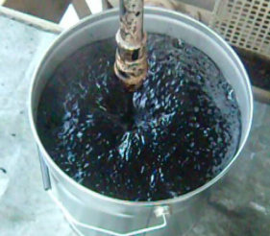
Bitumen Foaming
+
+
=
Hot Bitumen
160°C
Cold Water
2 - 4%
Fine Distribution
Bitumen Foam
1 litre
0.03 litre
20 litres
5 % of asphalt
0.15%
of asphalt
water: 0.05%
of asphalt

Slide 10

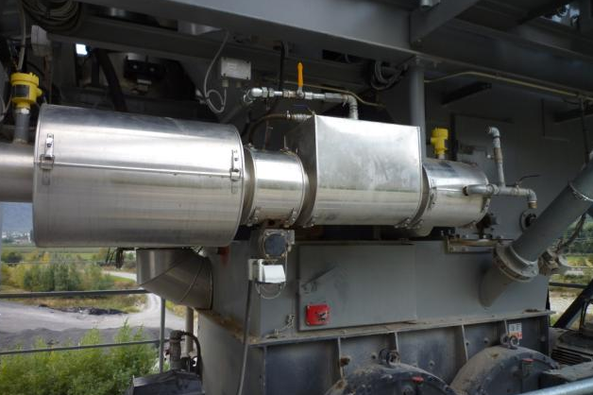
Ammann Foam Generator – Basic Principle
Foaming water
2-4% of bitumen
(0.1-0.2% of asphalt)
Static Mixer
Hot Bitumen
High pressure (water & bitumen)
Spraying nozzles
Foamed bitumen
Mixer
Notes:
The Ammann Foam Generator is the core components for producing low temperature asphalt with foamed bitumen. Hot bitumen is pumped into the foam generator. Cold water is injected and mixed with the hot bitumen. The mixing of water and bitumen takes place under high pressure. The water/bitumen mixture is pressed through the nozzles and after it has left the foam generator, the water expands and the foam is generated.

Slide 11
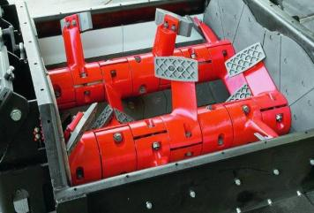
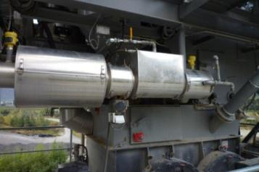
Ammann Foam – Pure Foam Bitumen - 100 – 120 °C
Notes:
Wichtig: Gut arbeitender Mischer, angepasste Mischsequenz

Slide 12
Ammann Warm Foam - Switzerland 2009
Water
Bitumen
Bitumen
& Water
Mixer
Sample
Taking

Slide 13
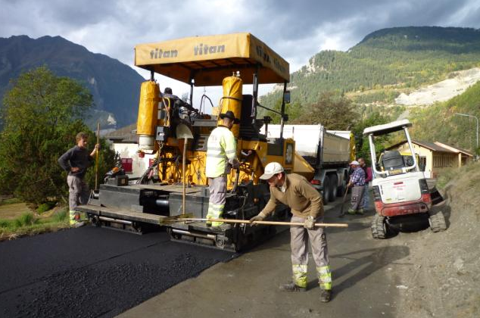
Ammann Warm Foam - Switzerland 2009

Slide 14

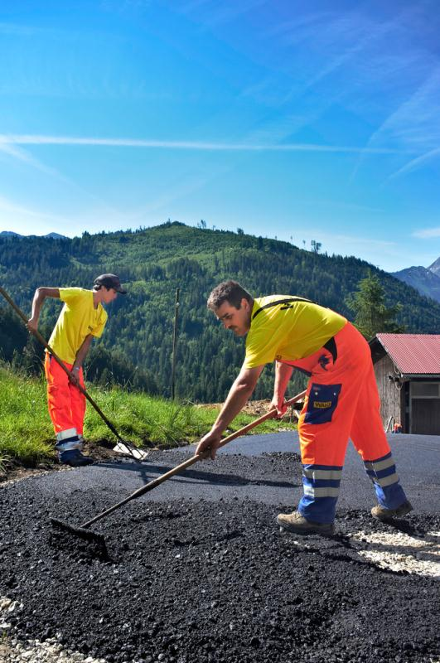
Foam Asphalt - Switzerland – 2012 – 115°C

Slide 15
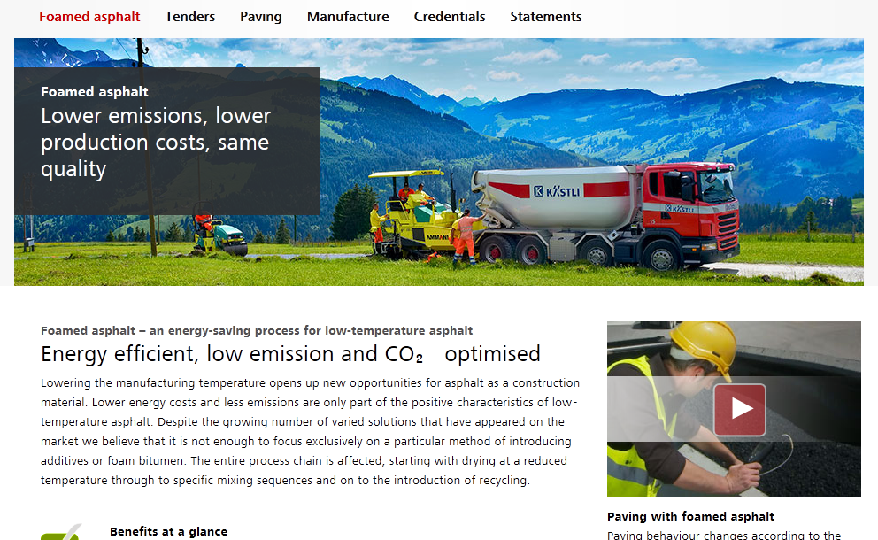
Low Temperature Asphalt Promotion
www.foamasphalt.info

Slide 16

Low Temperature Asphalt: All Parties have to Contribute
National and state road authorities
Supporting new technologies
Road construction companies
Investing in new technologies
Ammann
Developing new technologies

Slide 17
Productivity Partnership for a Lifetime
www.ammann-group.com

