Slide 1
Re-use and Recycling of construction wastes in France
By Jean Paul Michaut

Slide 2
Content
Reclaimed asphalt
In situ surface recycling
Deconstruction product
In situ depth recycling

Slide 3
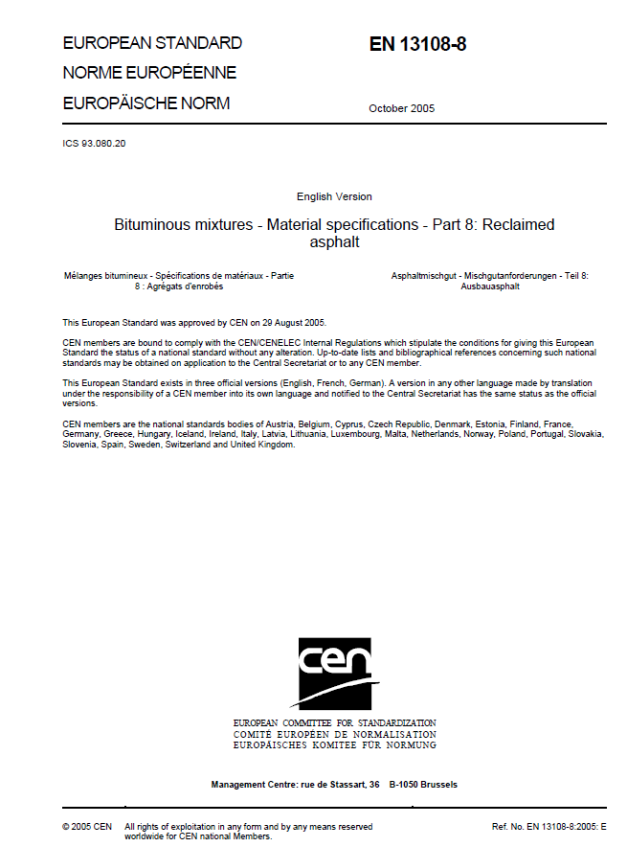

Reclaimed aspHalt
European standard: 13108-8
Specific French document
French health legislation
PAH content < 50mg/kg

Slide 4
European standard 13108-8
Up to 10 % for wearing and 20 % for binder and base course
Description of the feed stock
  More than 10 or 20 %: at least 5 samplings (penetration, grading curve) 1 per 500T
  Less than 10 or 20% : 1 sampling per 2000 t

Slide 5
Reclaimed asphalt EN 13108-8 new draft
Some definitions:
site-won asphalt : the material to be recycled either in the form of milled asphalt road layers, or as slabs ripped up from asphalt pavements, or being asphalt from reject or surplus production. These materials will require assessment and often processing before being suitable as a constituent material.
reclaimed asphalt: the processed site-won asphalt, suitable and ready to be used as constituent material for asphalt, after being tested, assessed and classified according to this standard.

Slide 6
Reclaimed asphalt EN 13108-8
new draft
Up to 10 % for wearing and 20 % for binder and base course
Description of the feedstock
  More than 10 or 20% (at least 5 samplings)
  Less than 10 or 20% : 1 sampling per feedstock
Level | Tons / test
X | 500
Y | 1.000
Z | 2.000

Slide 7
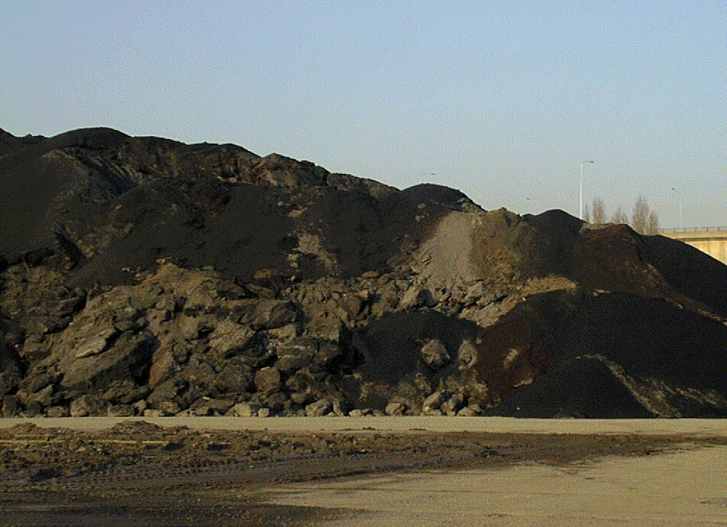
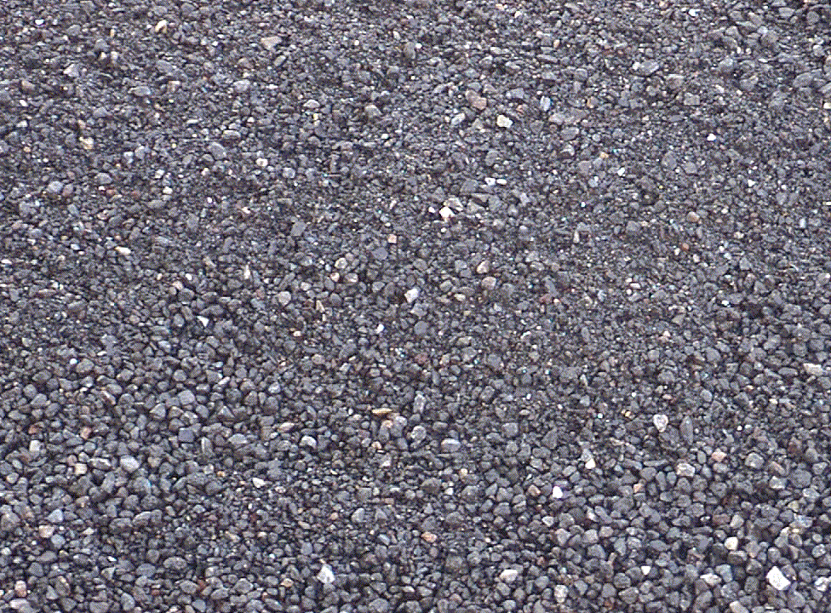
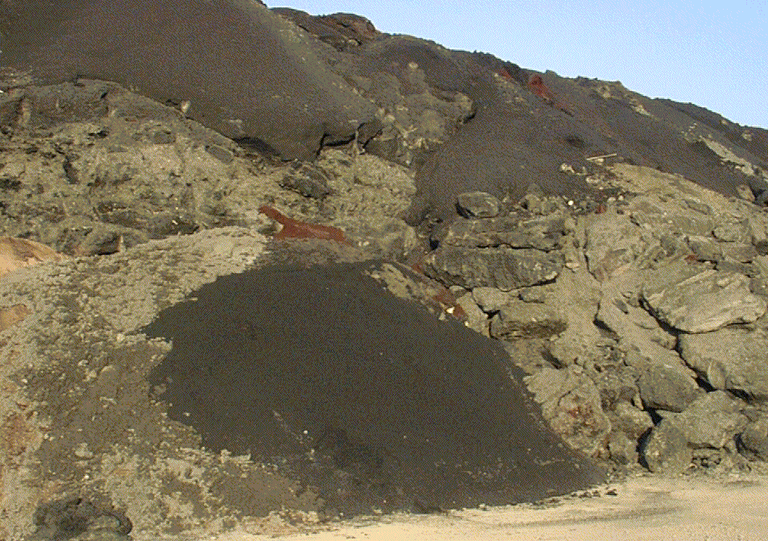
Site Won
Reclaimed Asphalt

Slide 8
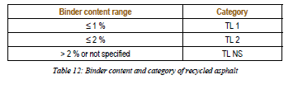
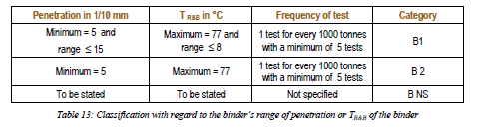
Reclaimed asphalt identification
Average binder content and its range
Binder characteristics and its range

Slide 9
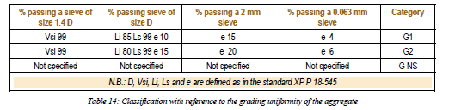

Reclaimed asphalt identification
Reclaimed asphalt grading curve
Intrinsic characteristics

Slide 10
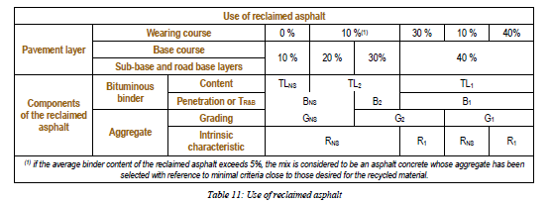
French addition for RA use
According to the previous table, the final choice
Specific comment: for Very thin asphalt concrete, Use of RA is not advised

Slide 11
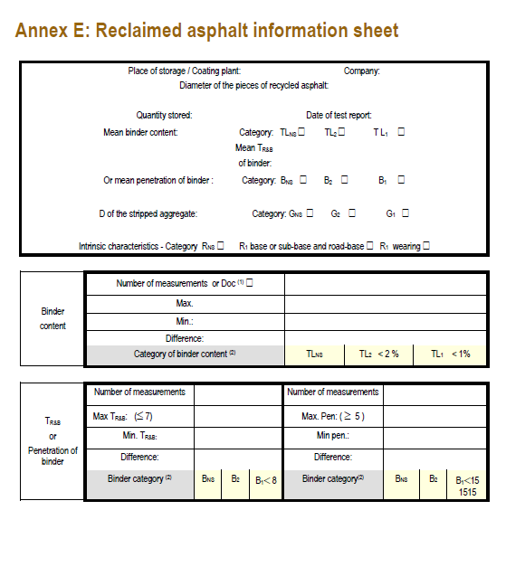
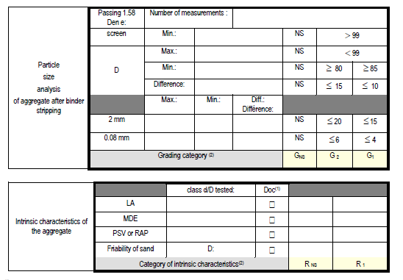
RA: identification Spreadsheet

Slide 12
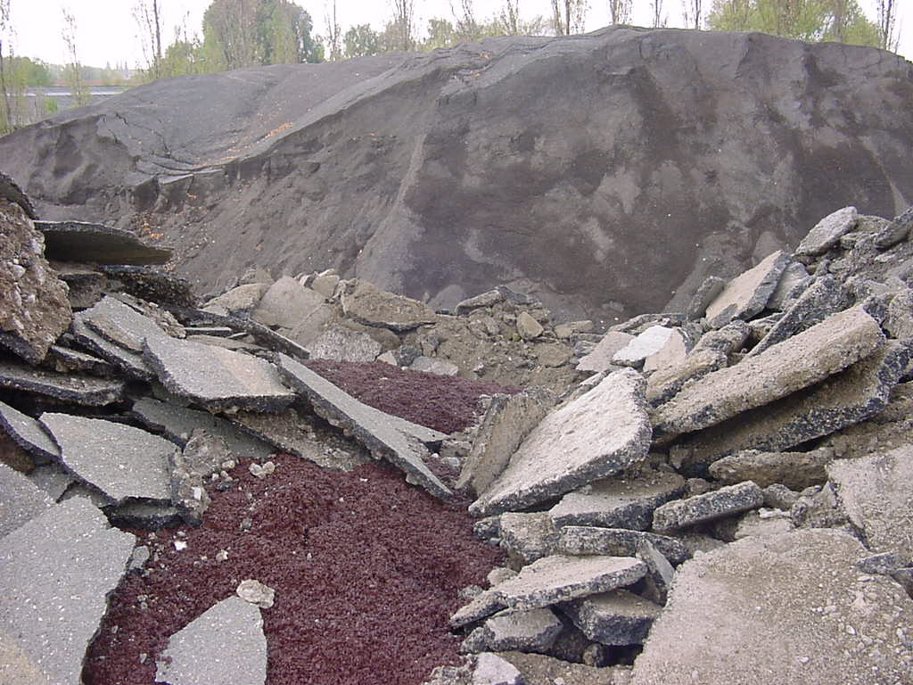
Re-use and recycling aggregates
Recycled road material and cement concrete
  Selective collection
  Same elaboration that quarry aggregate
  According to sort and elaboration, soil or aggregate are obtained
Reclaimed asphalt
  Milling
  Selective collection and crushing
  European standard
  Percentage of use according to the RA knowledge

Slide 13
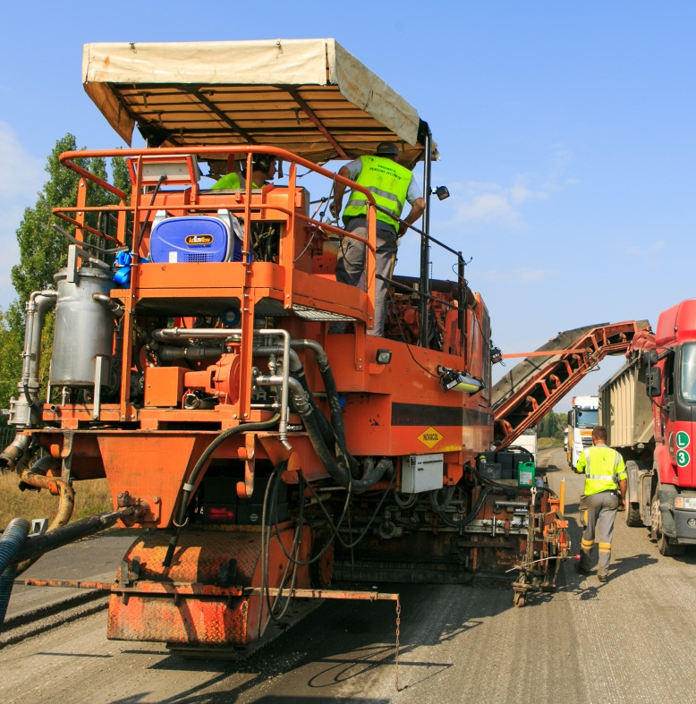
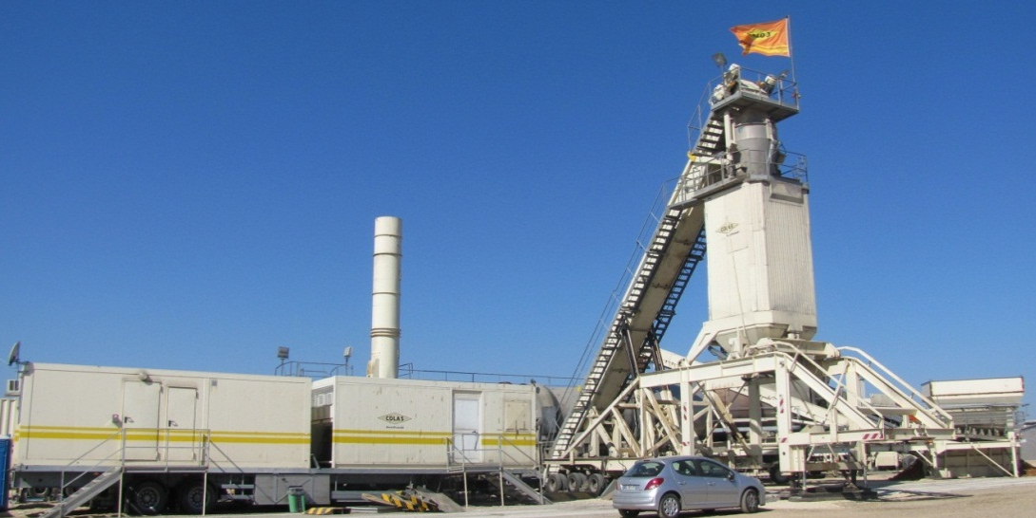
Example A 54 in France
20% RAP in Asphalt Concrete Wearing course
50% RAP in Asphalt concrete Wearing course
60% RAP in EME2
Special plant

Slide 14
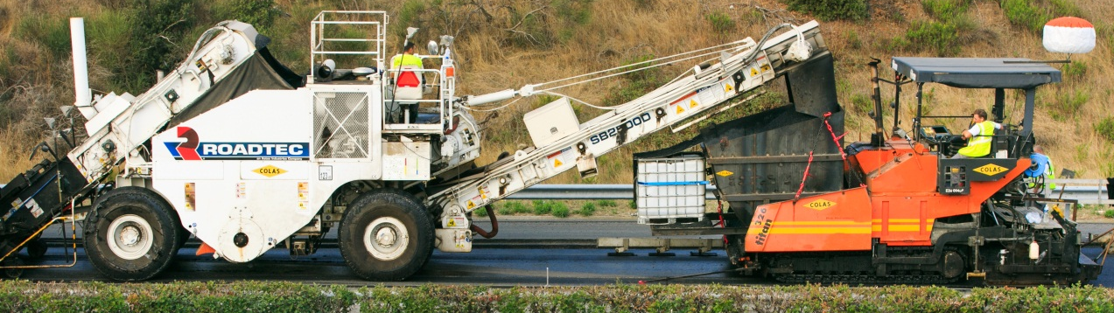
Sampling and results
Binder content : 5 % (4,4 to 5,5)
Penetration: 14^{1/10mm} (5 to 20)
Softening point: 69°C (62,6 to 88,5)
Passing sieve at 0,063mm: 9,7%
Passing sive at 2mm: 43%
Binder used : 2,6% of 10/20 for obtaining EME2 performances

Slide 15
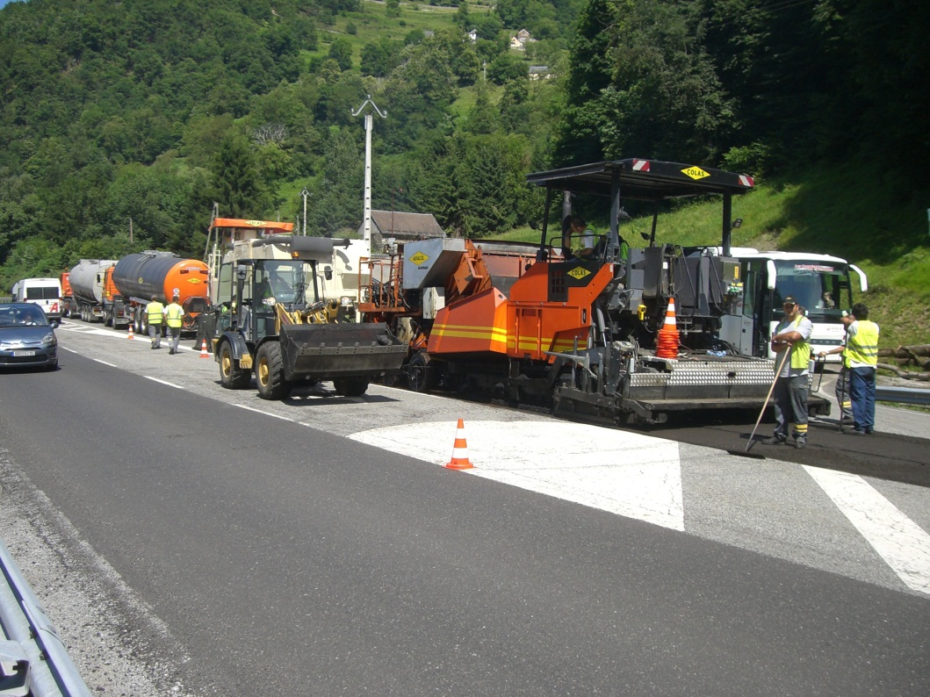
From rap to COLD in situ recycling

Slide 16
In situ recycling for surface problems
Concerns only wearing and binder course
Remedies to cracking and excessive binder ageing
Recycles the wearing course damaged by fatigue to form a new binder course
Correct bad bonding between wearing and binder courses

Slide 17
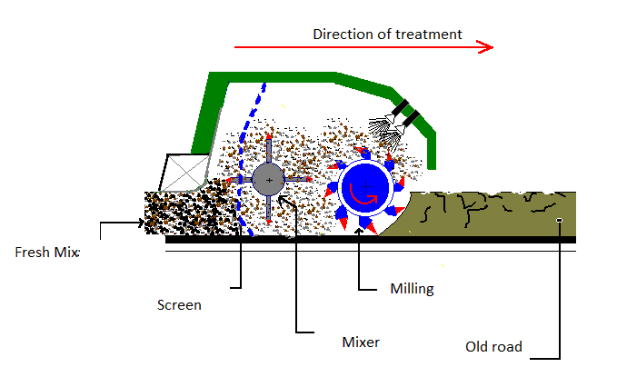
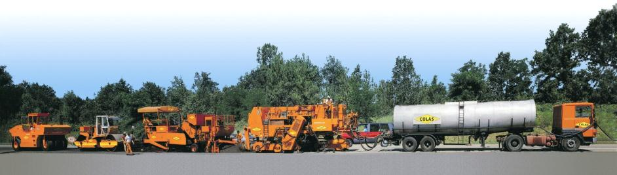
How it works
Milling the old pavement
Add emulsion or aggregate to obtain right grading curve and binder content
Lay this new cold asphalt concrete

Slide 18
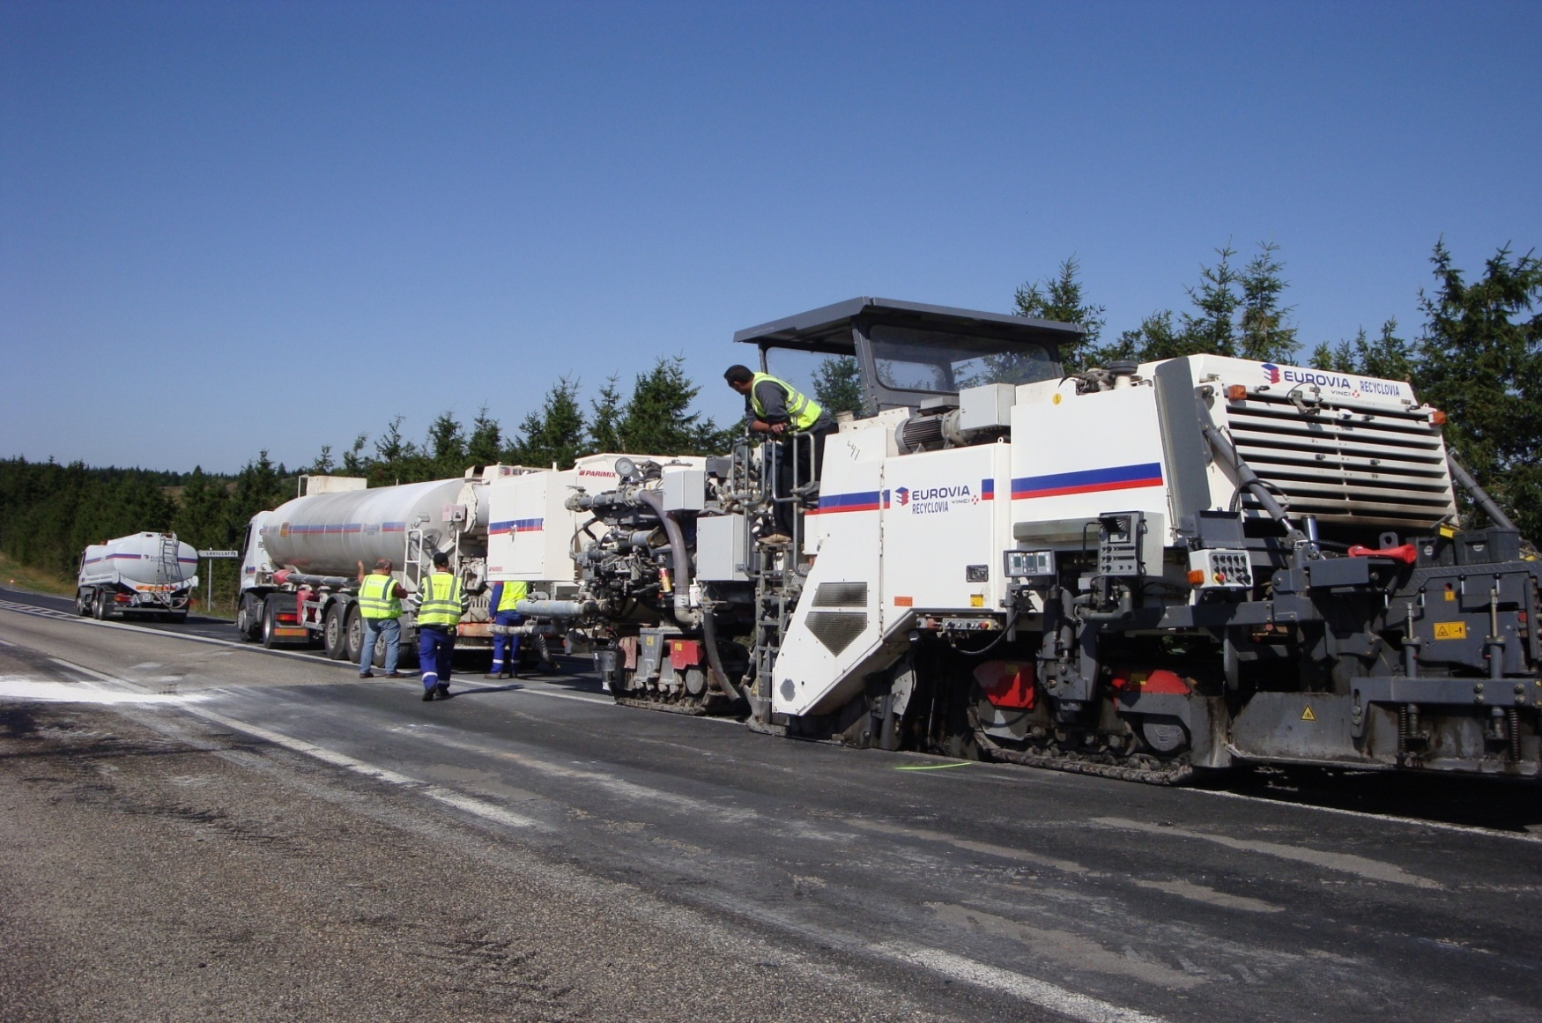
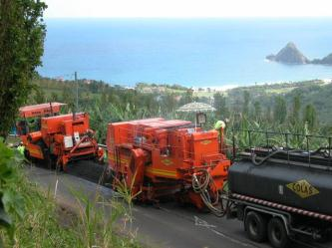
But before
Need cores for analyzing the old course
  Penetration, Softening point
  Grading curve and binder content
Add aggregate for the grading curve
Add special emulsion for binder rejuvenation

Slide 19
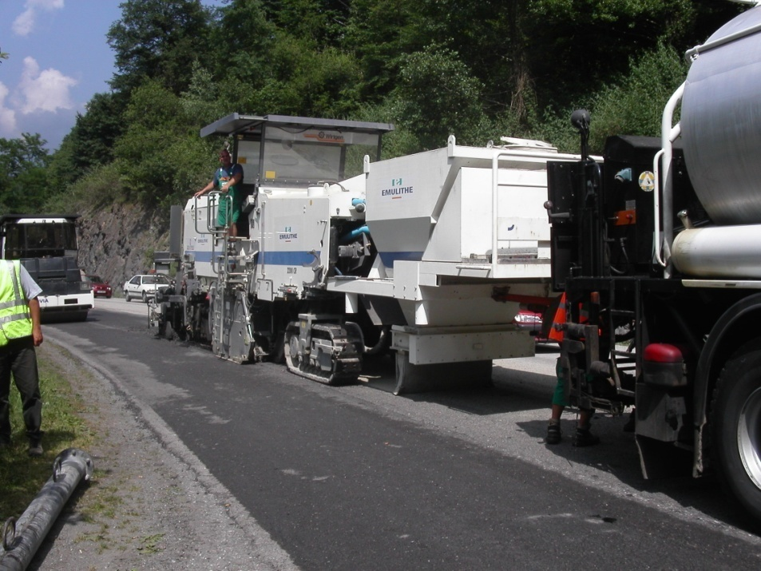
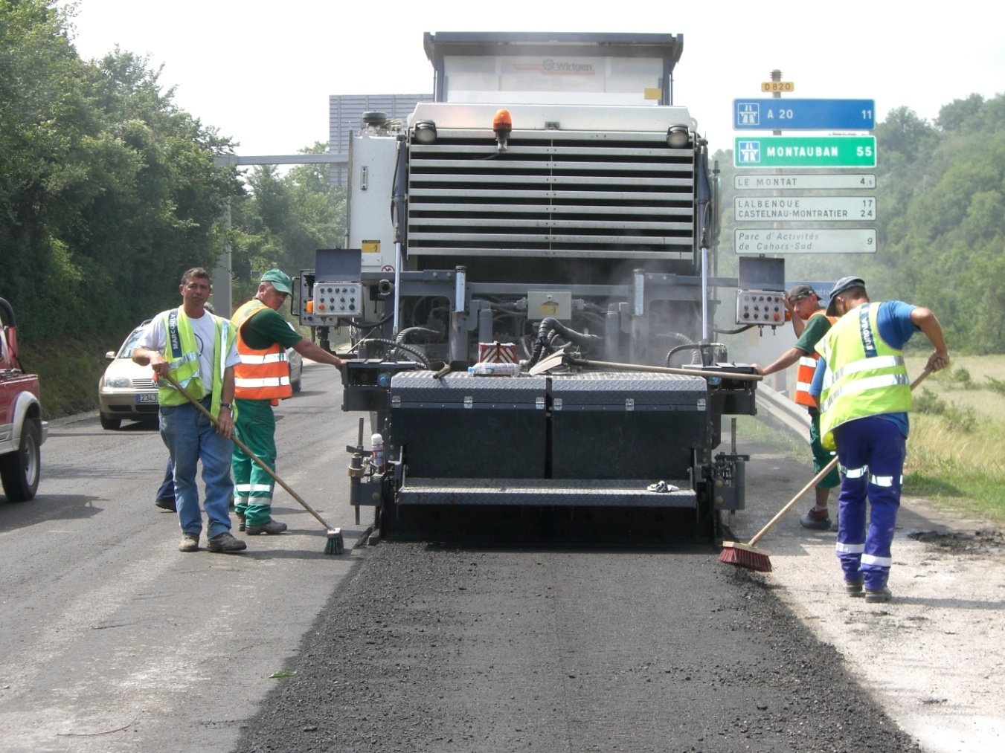
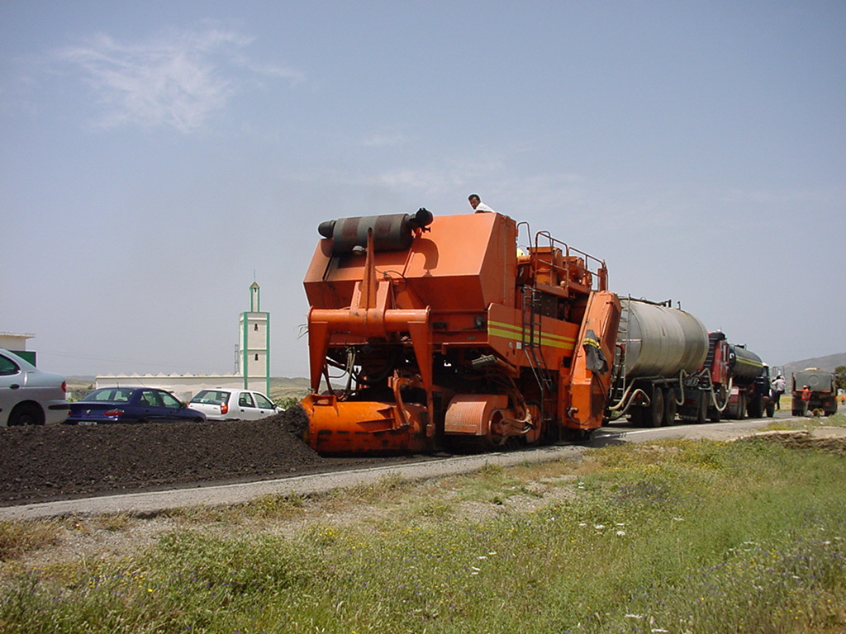
Cold in situ recycling
Workshop length (less than 200m)
Can be used under traffic

Slide 20
Conclusion
Deconstruction products can be reused in road construction after elaboration process (crushing, etc.) as sub base or base course treated or not
Reclaimed asphalt up to 100% for base course and wearing course according to the aggregate quality
In situ recycling can be used very often

Slide 21
Conclusion
Good performances
Easy to use and to formulate
All these techniques are in favor of environmental requirements
Less transport of raw materials, less energy consumption, less green house gas effect

Slide 22
Thank you for your attention
Hvala na pozornosti!

